Slide 1
Monday , December 27th 2021 Unit 6: Whose jacket is this? Lesson 4
1. Listen, point, and repeat.
Click here to listen

Slide 2
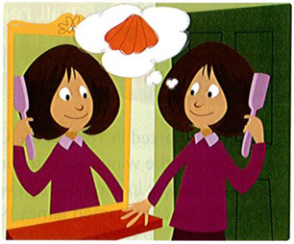
2. Listen and read.
Click here to listen
I'm waiting at the door, looking in the mirror, and brushing my hair.
I'm going to beach with my friend today!
I'm going to take my doll. Her name is Carrie.
We have a picnic: sandwiches, cheese, carrots, and cherries. We're going to look for shells and smell the ocean air. Oh! I can hear the doorbell.
My friend is here.

Slide 3
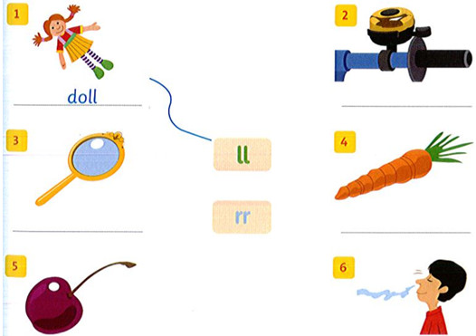
3. Read again. Circle the words with "ll" and underline the words with "rr".
Lời giải chi tiết:
"ll": doll, shells, smell, doorbell.
"rr": mirror, Carrie, carrots, cherries.
4. Match and write.

